Slide 1
Let’s talk about Camera
汽14 2011010782 杨智

Slide 2


Game
SNS
Art

Slide 3
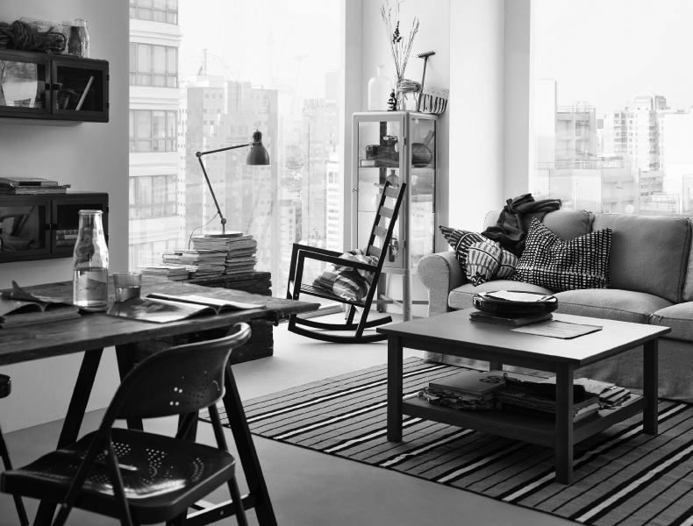

BOOK
PK

Slide 4
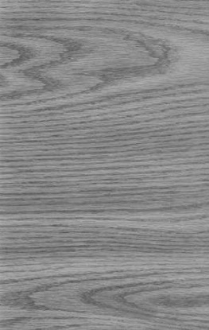
WOOD
BRIDGE

Slide 5
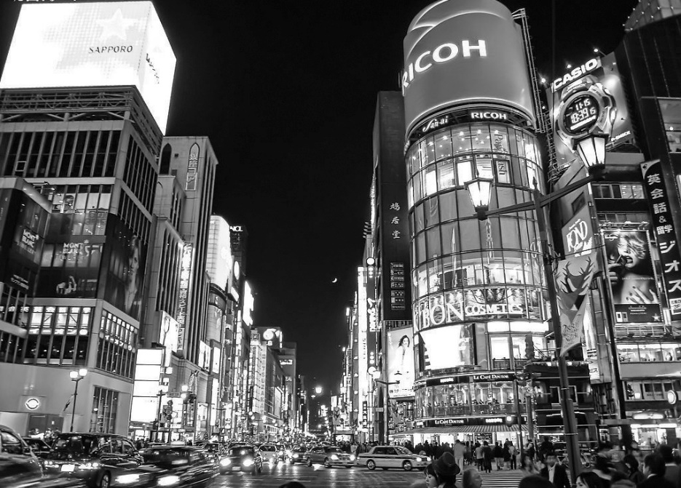


39.9139° N, 116.3917° E

Slide 6

Future
Now
PhotoSurround
Past

Slide 7
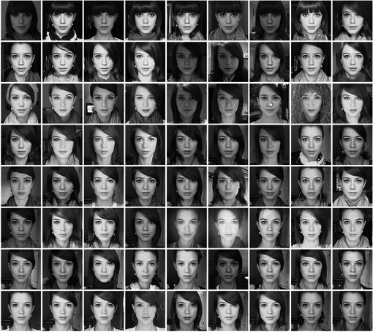

Slide 8
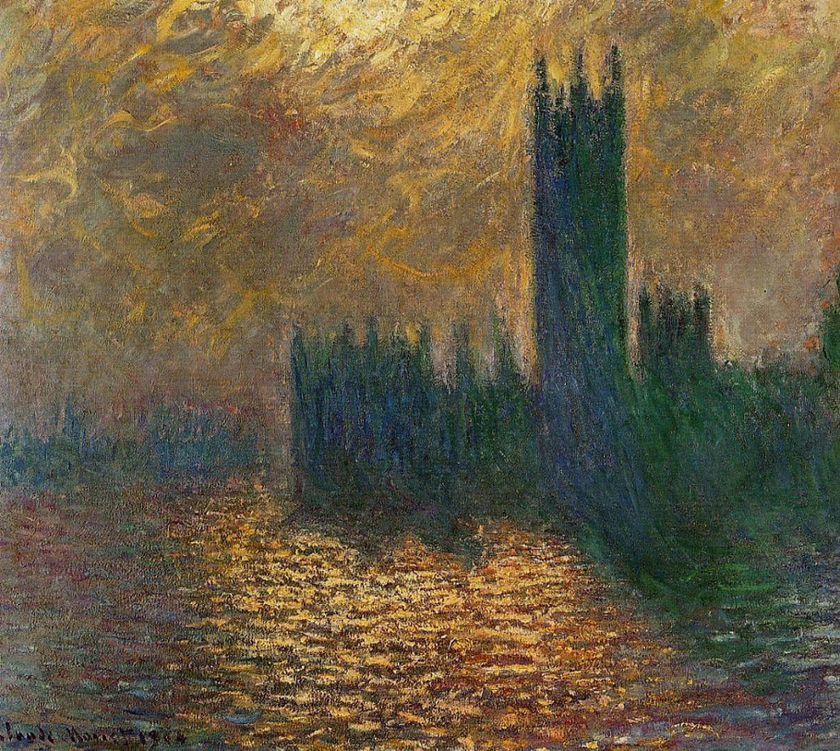
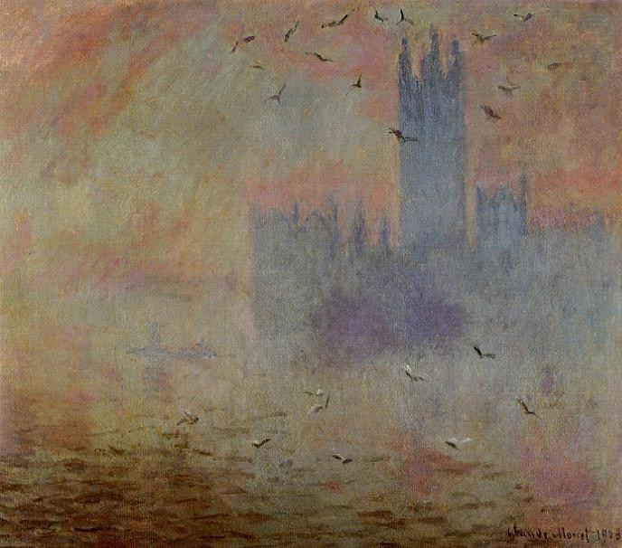
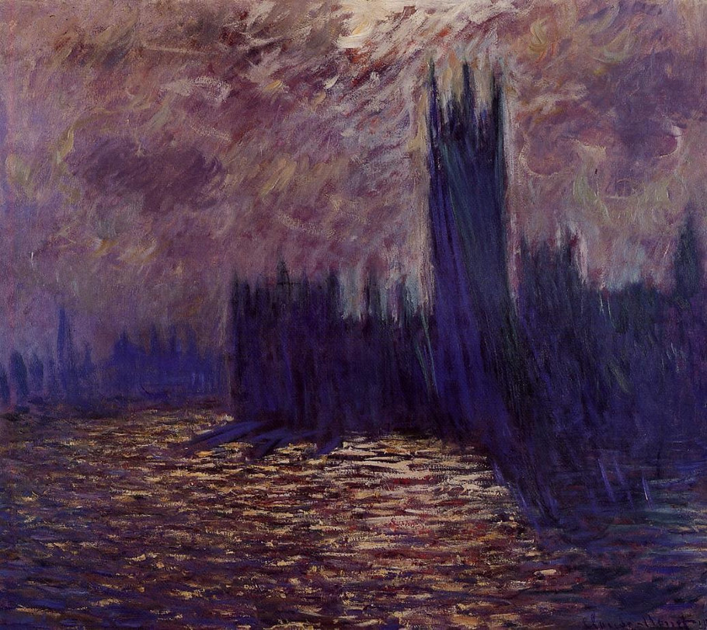
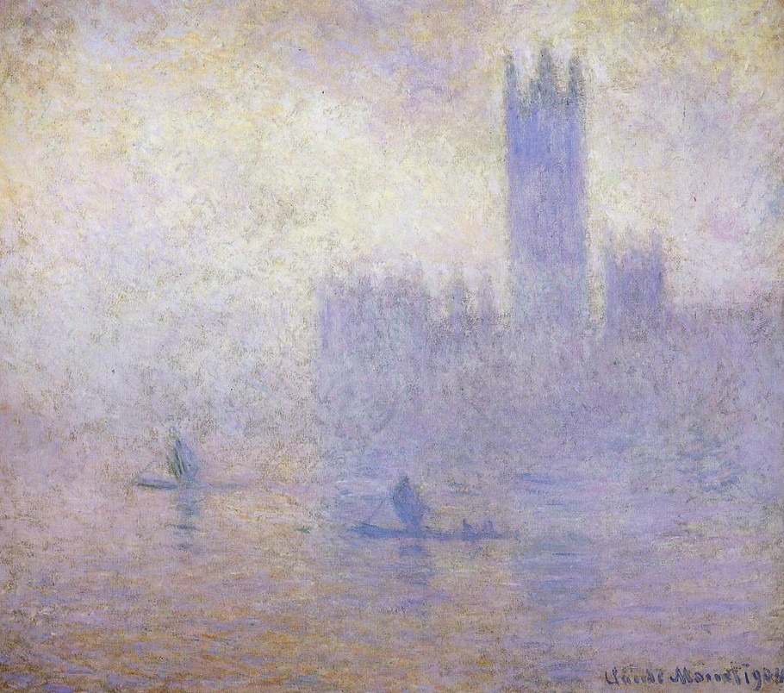
Feeling
Effect

